Slide 1
INFSCI 2595 Final Project
Spring 2022
Zhenyu Li

Slide 2
Outline
Regression
EDA
Models
Classification
EDA
Models
Conclusions

Slide 3
Regression
Predict the time spent on product sale by a sale representative (response) using categorical inputs like region, customer, and sentiment derived features.

Slide 4
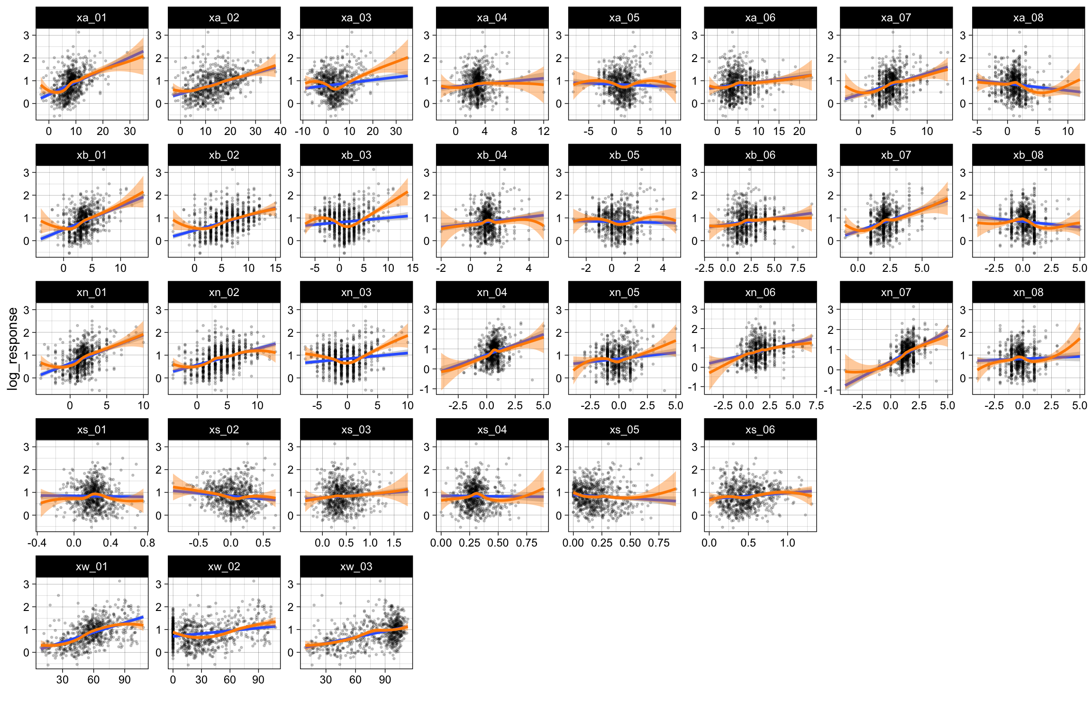
Regression EDA Trend for each continuous input
Some inputs that may have nonlinear relation to the response (sale time). Some examples are highlighted.

Slide 5
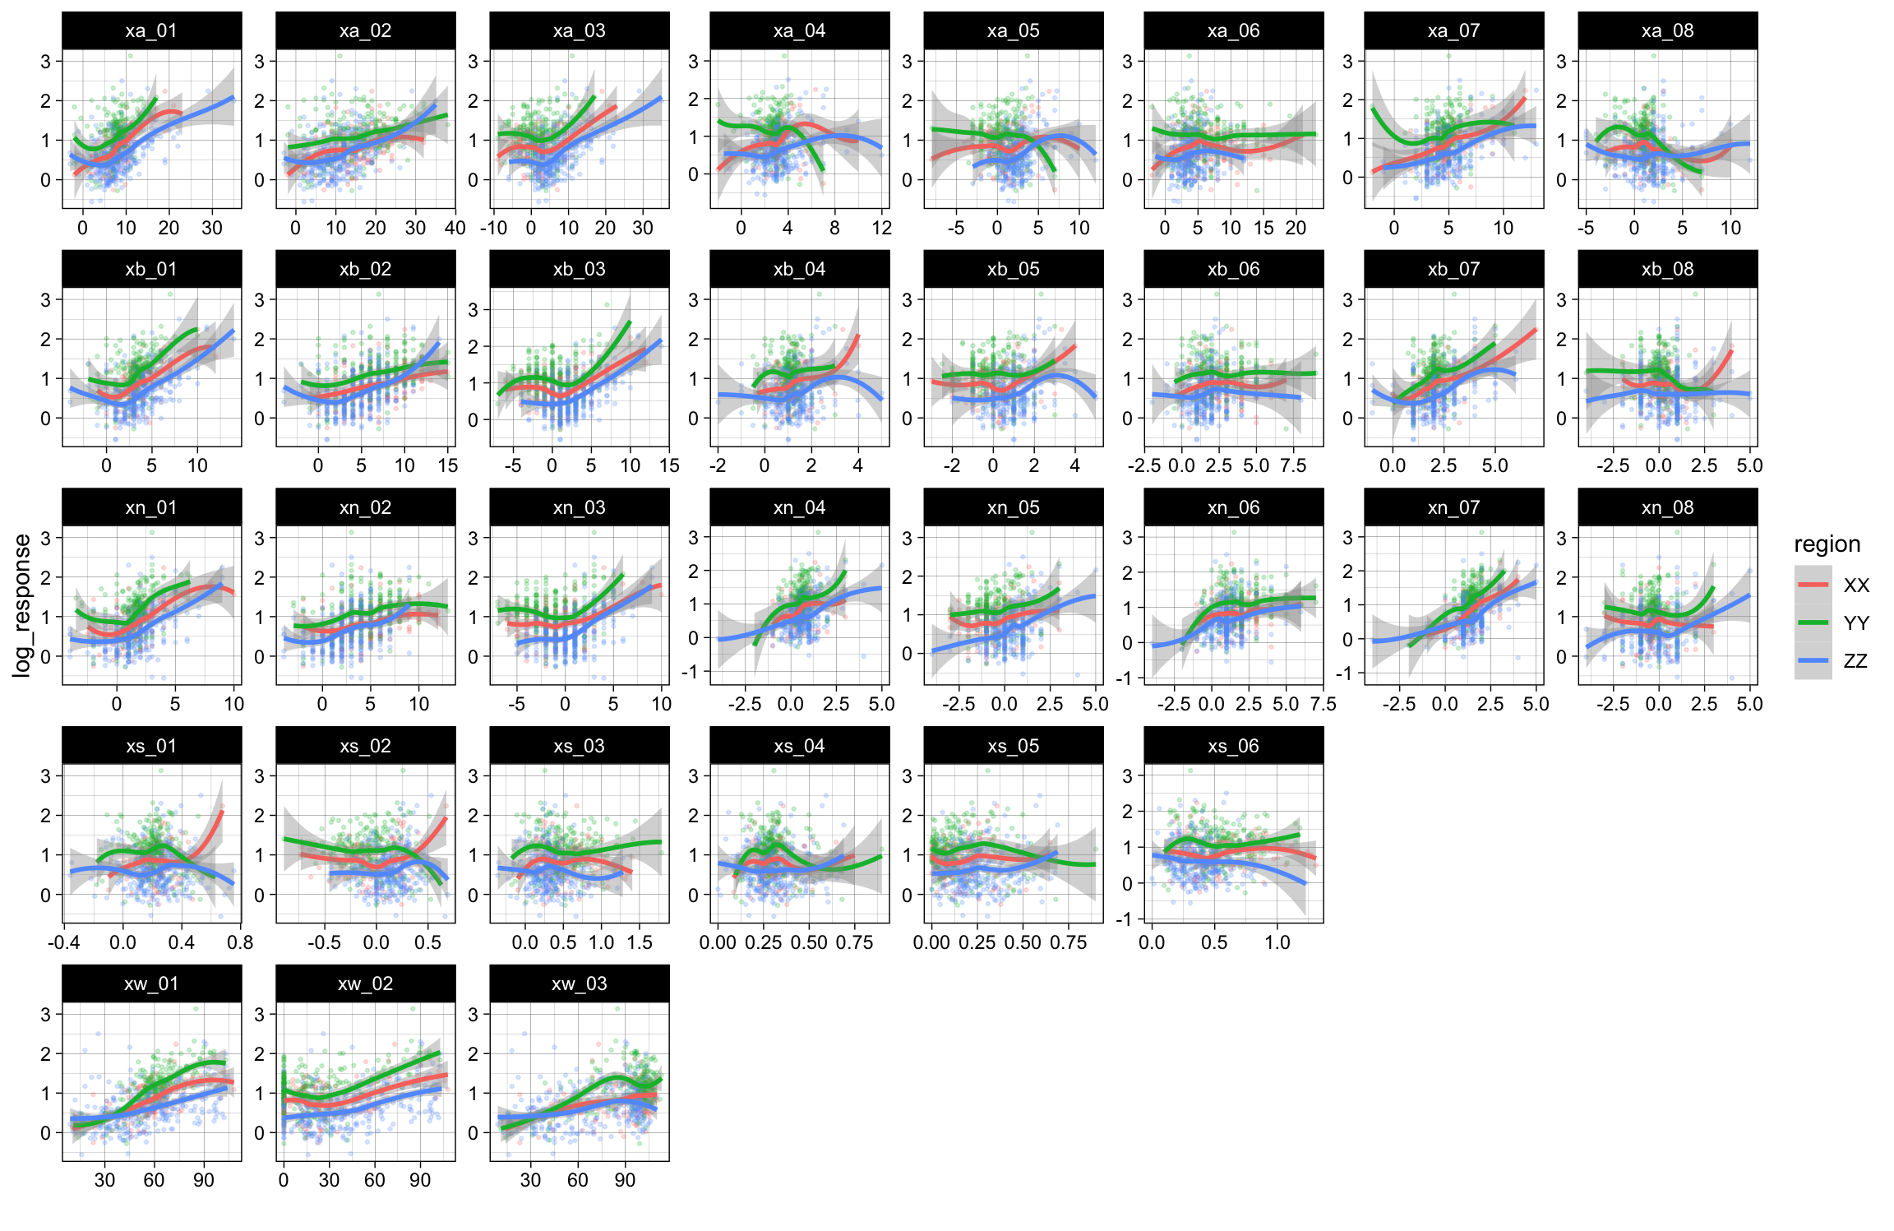
Regression EDA Trend Conditioned on Region
The region categorical input affects how continuous variables can predict the response (sale time).

Slide 6
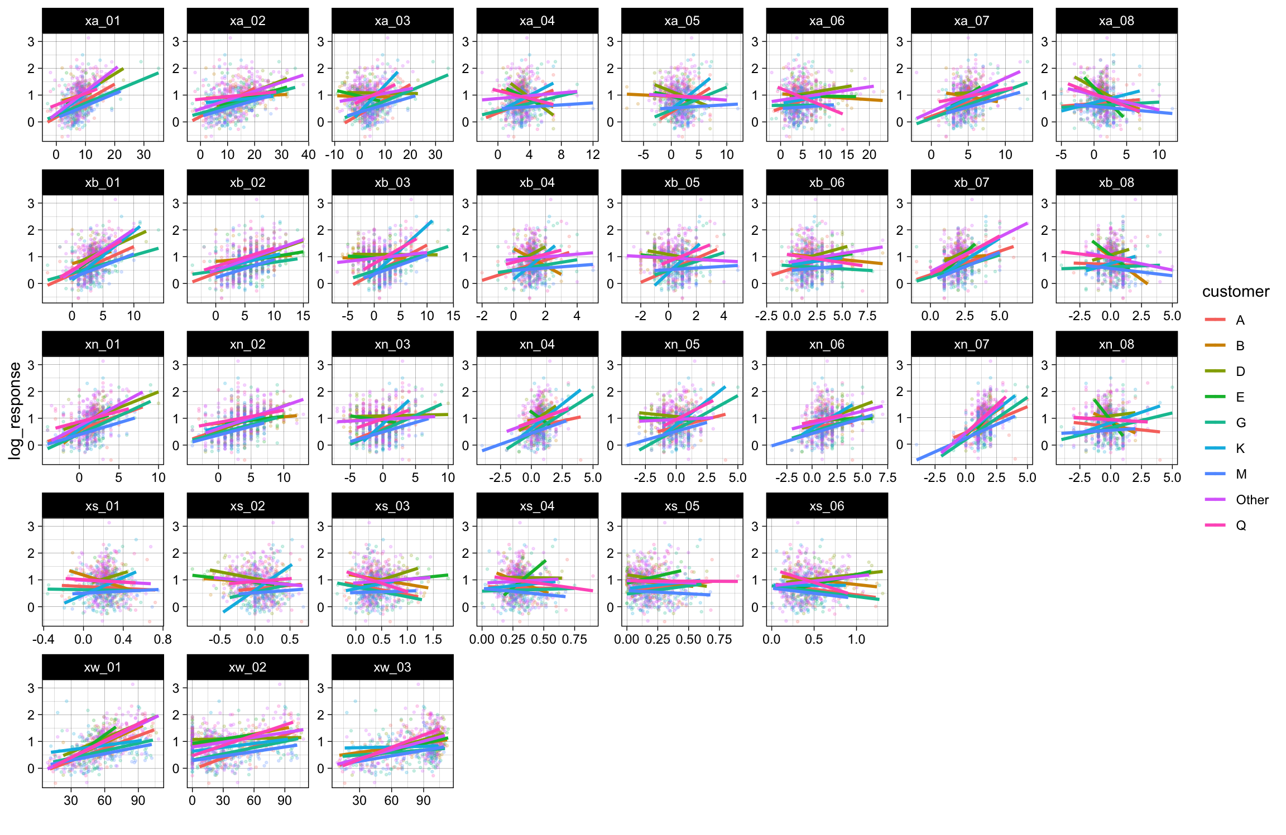
Regression EDA Trend Conditioned on Customer
The customer categorical input affects how continuous variables can predict the response (sale time).
(To simplify the visualization, a linear smoother is used with no uncertainty interval)

Slide 7
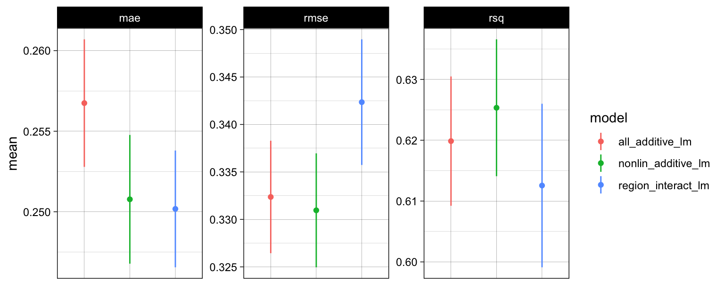
Regression Baseline Models
The best performing linear models with hand crafted features.
Red: all inputs - linear additive. Green: linear inputs and nonlinear features - linear additive. Blue: interact region to nonlinear features - linear additive.
The model with linear additive of non-linear features is the best.

Slide 8
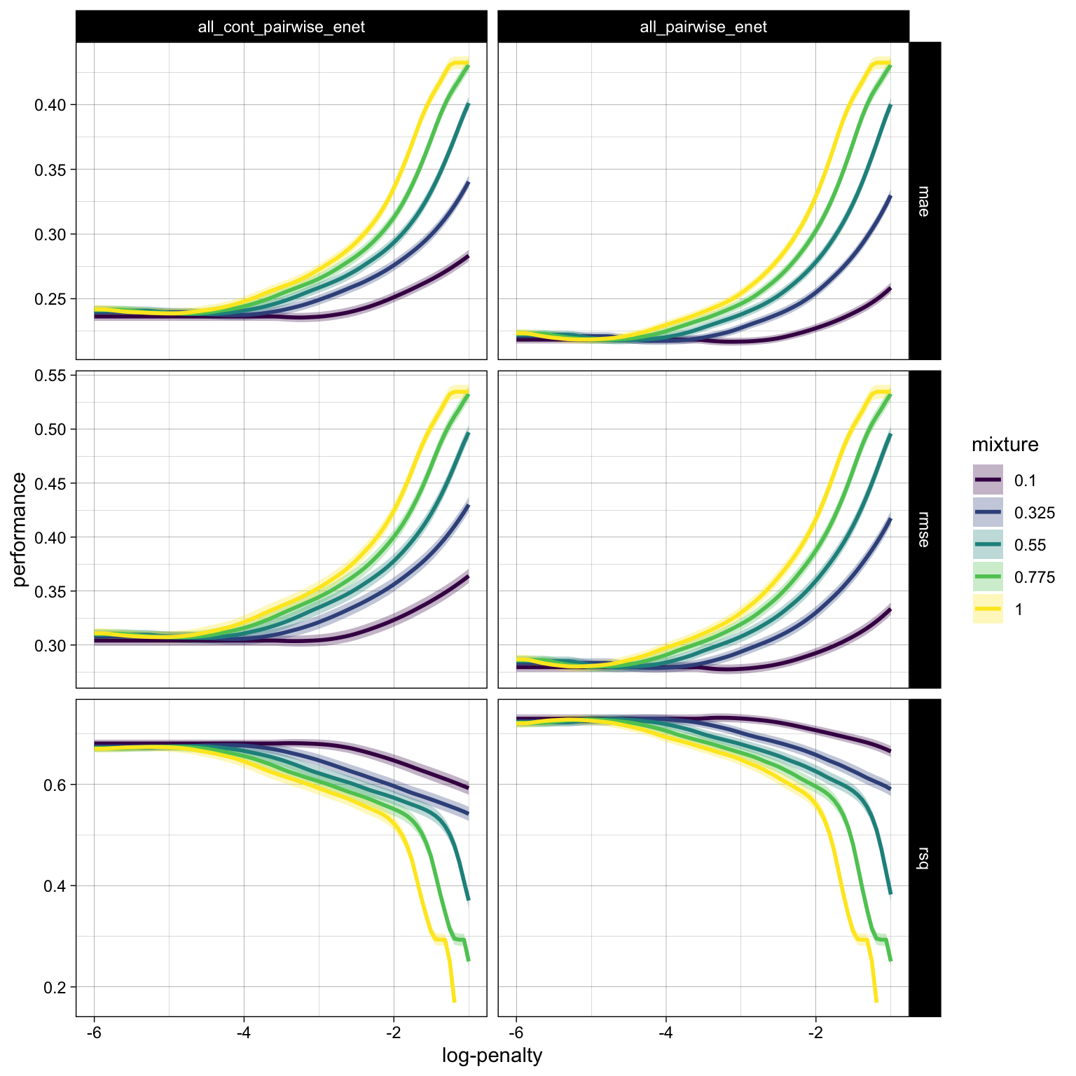
Regression Regularized Models (Elastic Net)
Two baseline models are selected for regularization with Elastic Net
Left: pairwise interactions for all continuous inputs, additive for categorical.
Right: pairwise interactions for all input variables
Models are tuned with 5x5 CV with customized penalize and mixing parameters.
Performance metrics are plotted w.r.t. the log-penalty range.

Slide 9
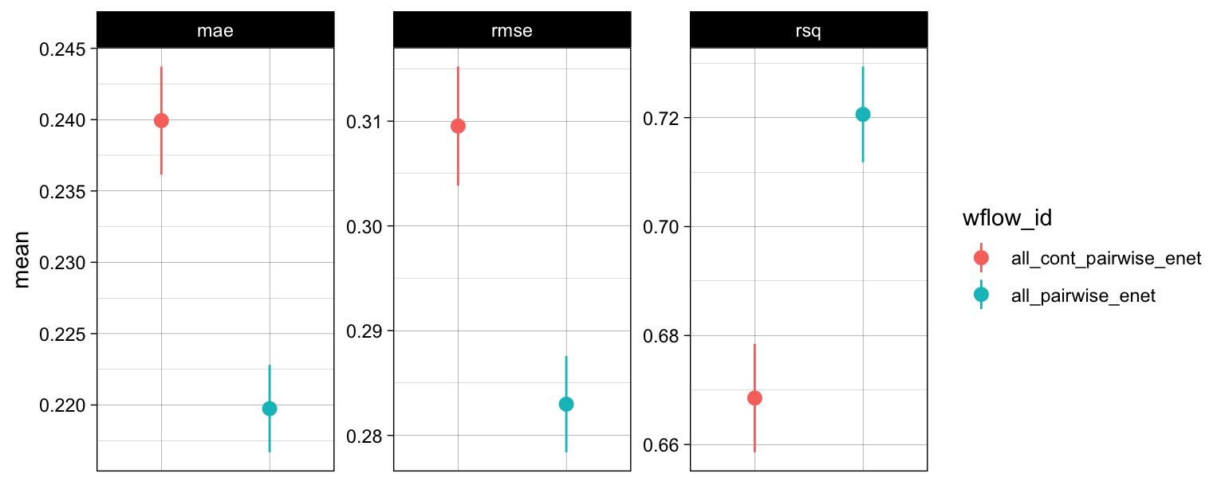
Regression Regularized Models (Elastic Net)
Two baseline models are selected for regularization with Elastic Net
Red: pairwise interactions for continuous inputs, additive to categorical.
Teal: pairwise interactions for all input variables.
The best of each model is selected by RMSE and compared.
The all-input-pairwise model has better performance.

Slide 10
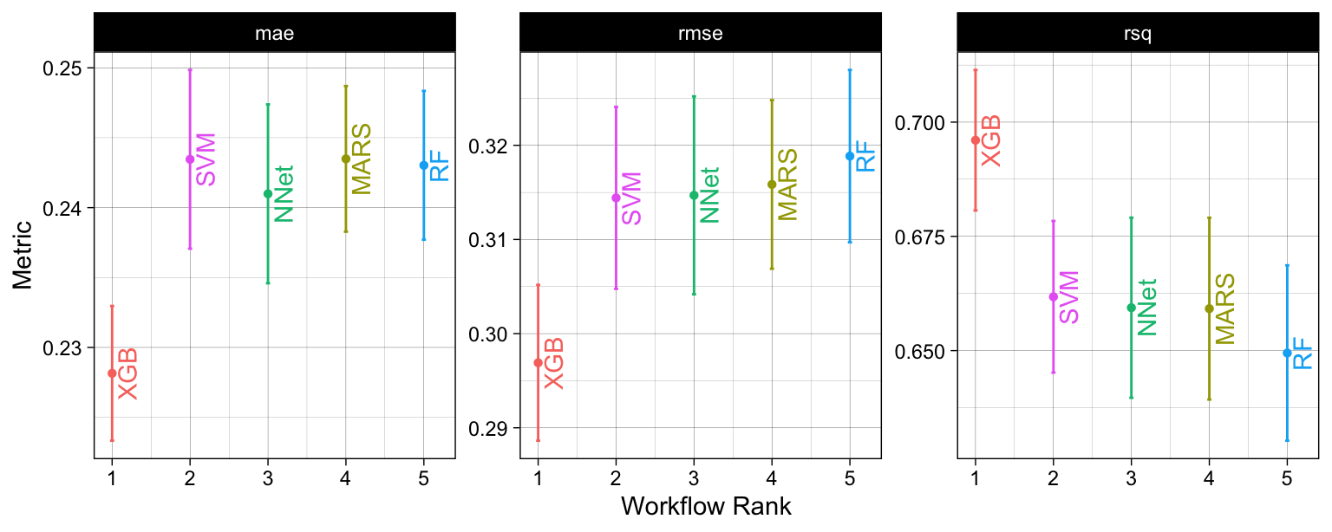
Regression Advanced Nonlinear Models
Five advanced models are tuned, each with 5x5 CV using tidymodels’ default tuning grids of 20 combinations for tuning parameters.
The best of each model is selected and compared.
The best model is identified as the XGB model.

Slide 11
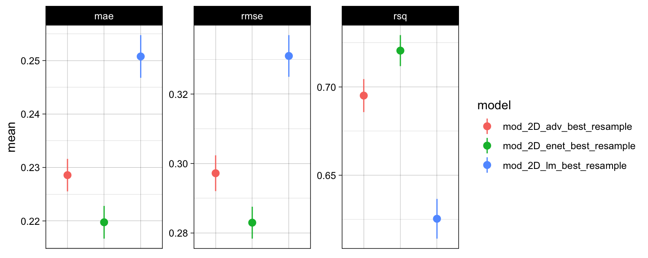
Regression Best Model
The best model from each section (baseline lm, regularized lm, advanced models) are pooled together for comparison.
The best model for the regression task is identified as the Elastic Net model with interactions from all inputs.

Slide 12
Classification
Predict if the sale goal for a product is met (outcome) using categorical inputs like region, customer, and sentiment derived features.

Slide 13
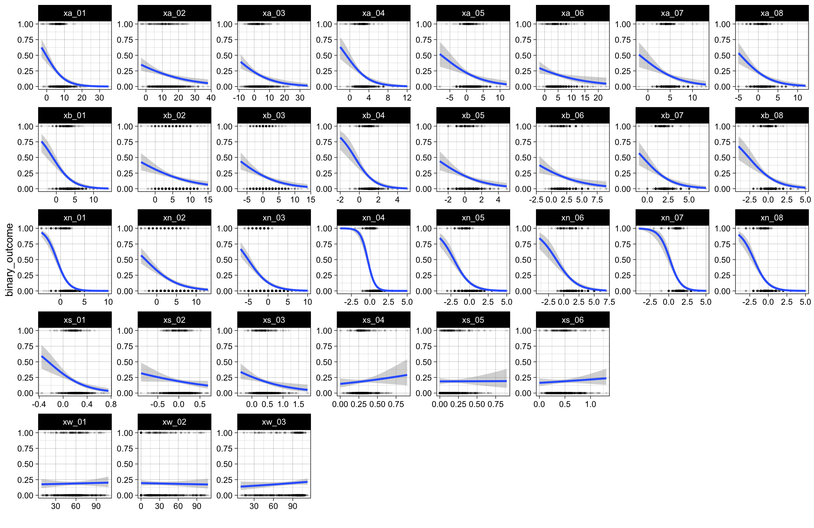
Classification EDA Trend for each continuous input
Some inputs that may be better at predicting event probability than others.

Slide 14
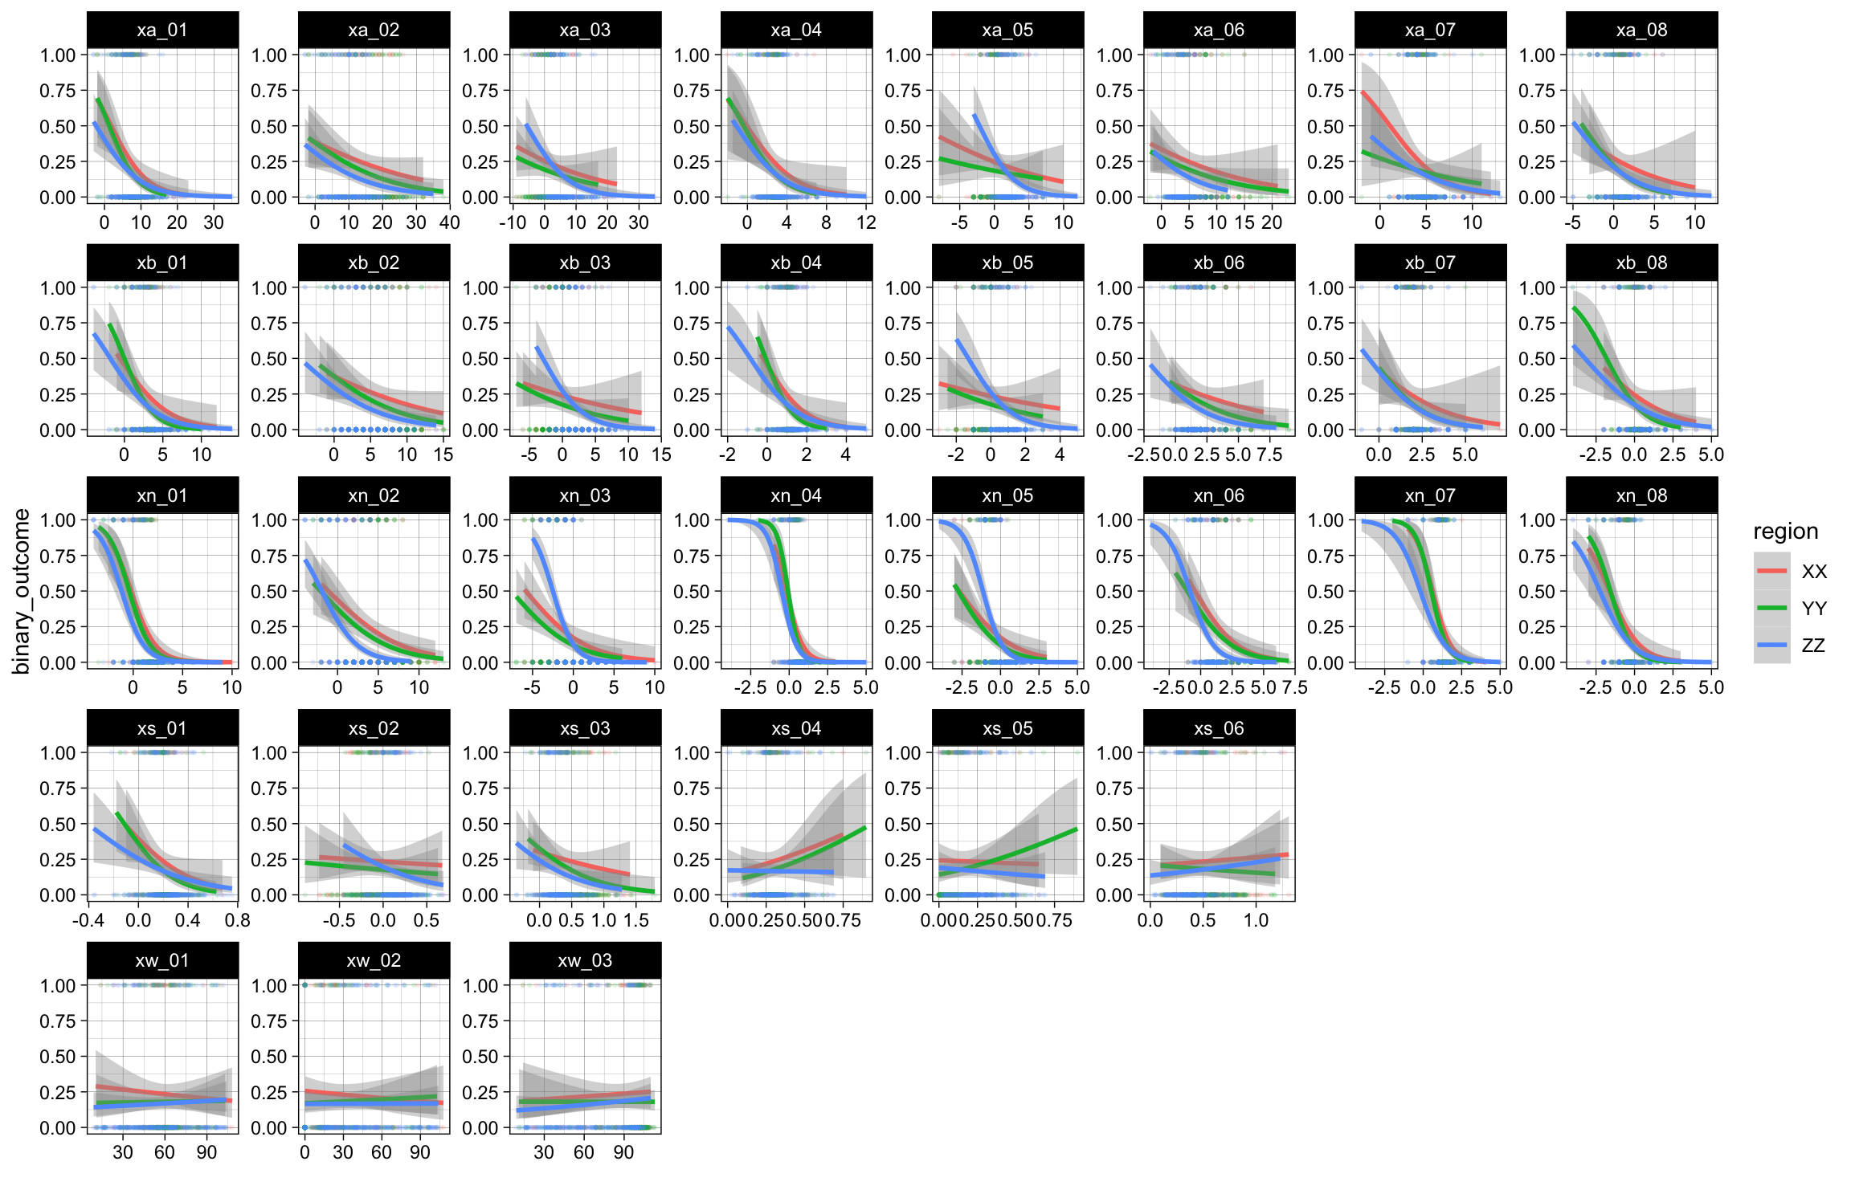
Classification EDA Trend Conditioned on Region
The region categorical input seems to affect prediction from some continuous inputs.

Slide 15
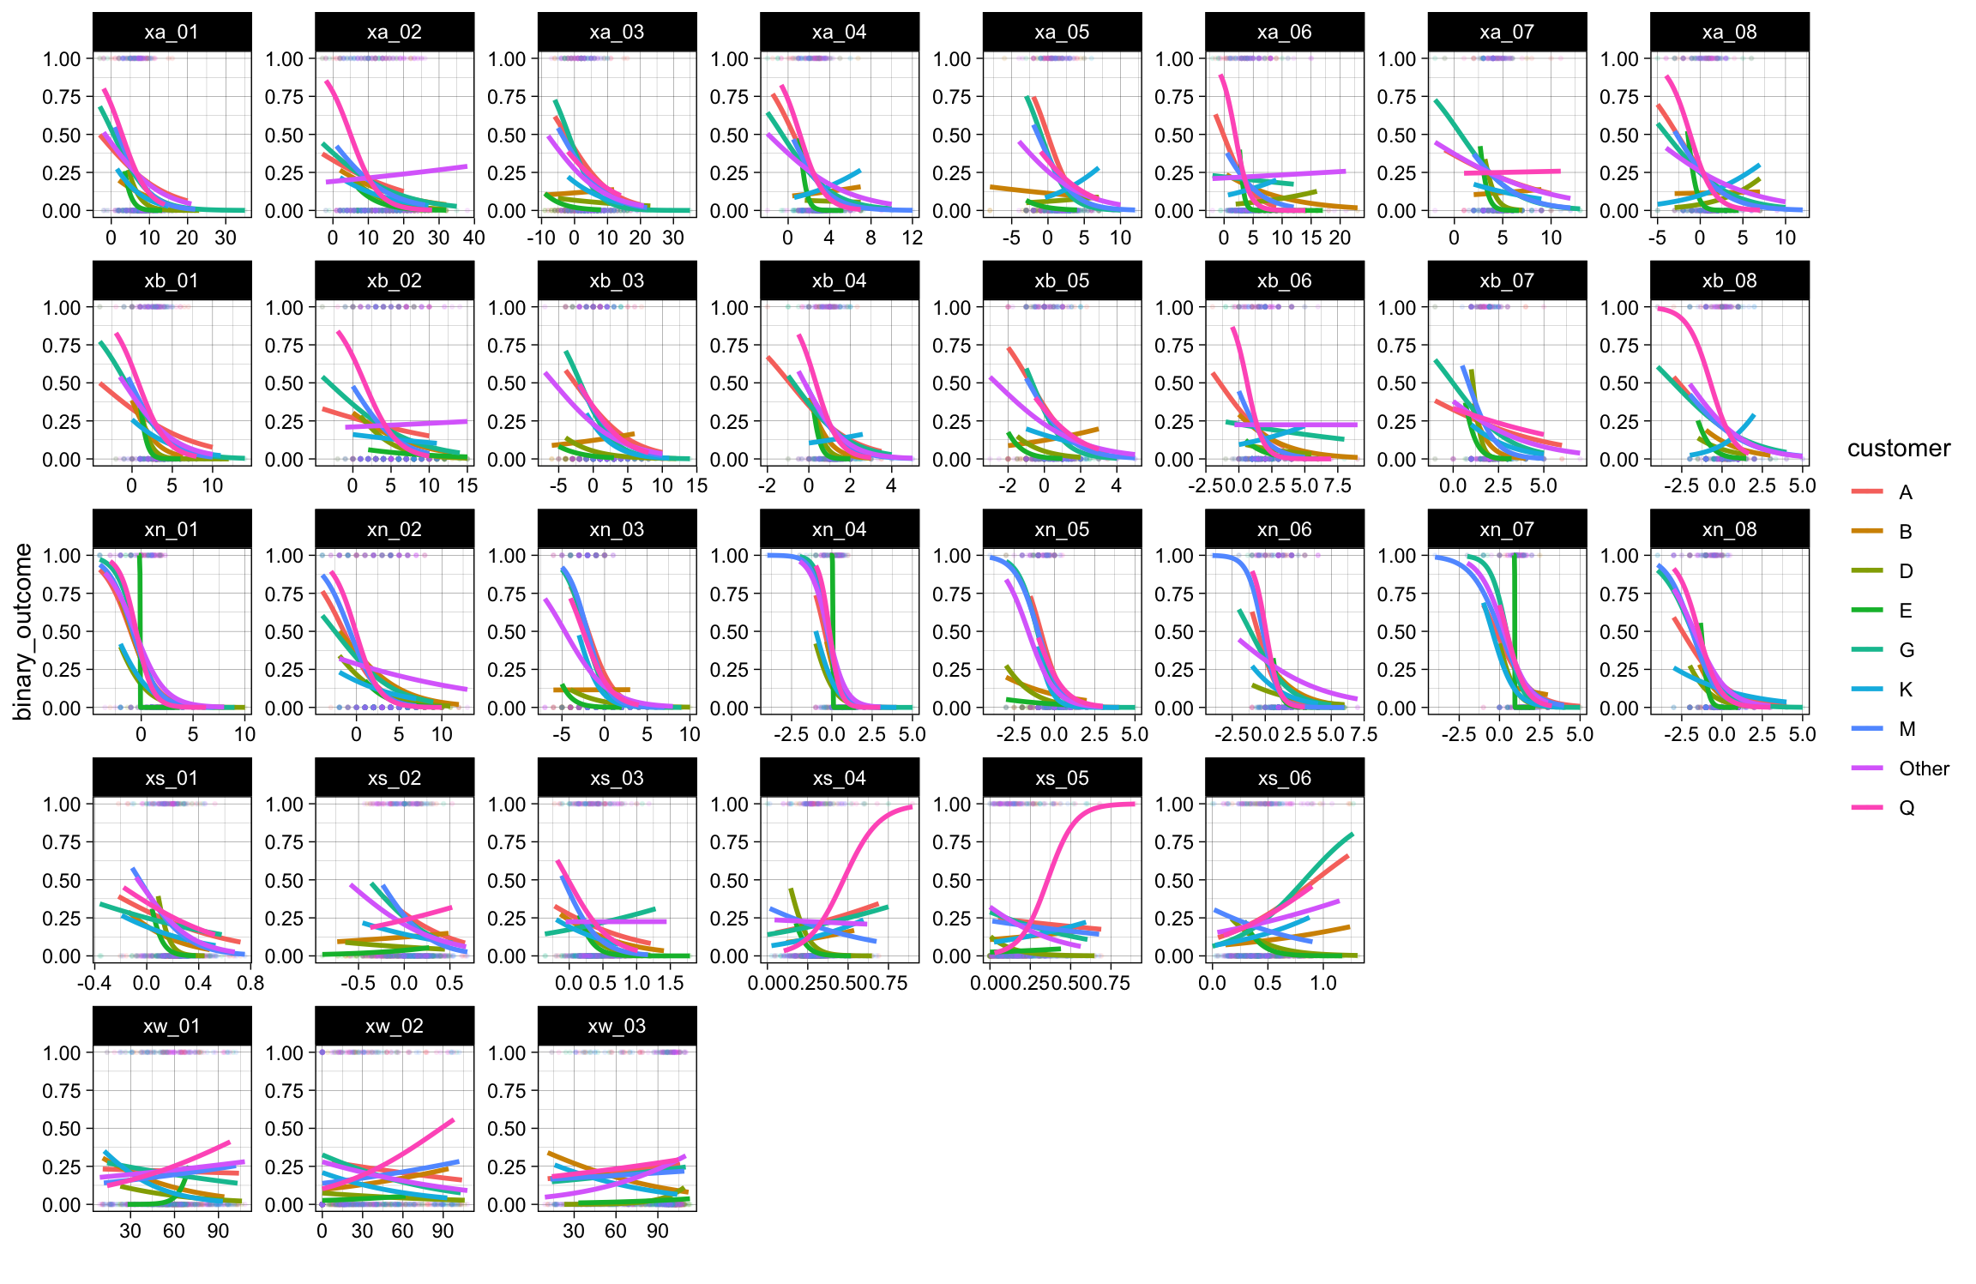
Classification EDA Trend Conditioned on Customer
The customer categorical input has great impact to how many continuous input may predict the event probability.

Slide 16
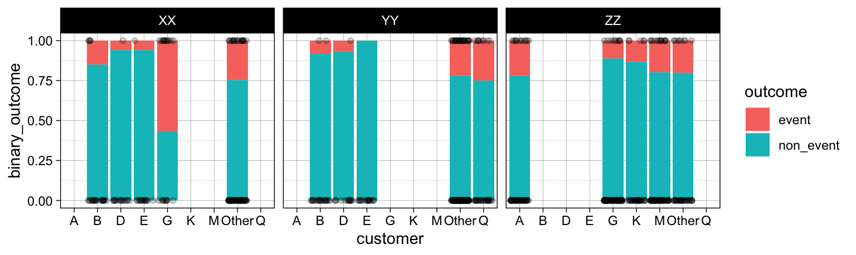
Classification EDA Event Probability
We see unbalanced events from the data set.
This problem is even worse for certain customers.
Because of this, I decided to use mean log loss as the main performance metric to compare classification performances.

Slide 17
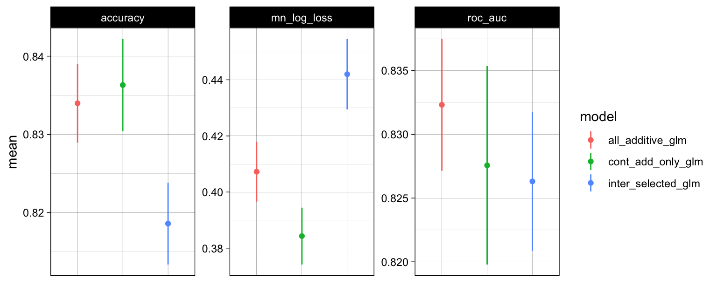
Classification Baseline Models
The best performing glm models with hand crafted features.
Red: all inputs - linear additive.
Green: continuous inputs only - linear additive.
Blue: interact some selected linear inputs.
The model with linear additive of continuous inputs is the best.

Slide 18
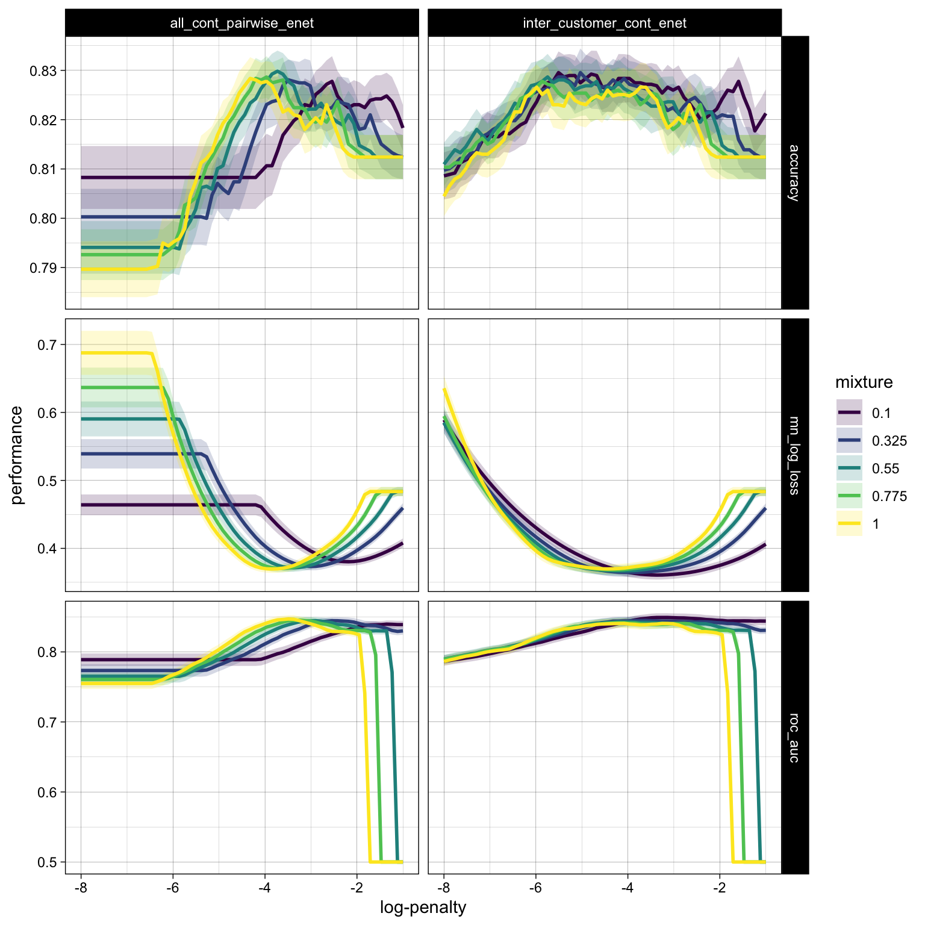
Classification Regularized Models (Elastic Net)
Two baseline models are selected for regularization with Elastic Net
Left: pairwise interactions for all continuous inputs, additive to categorical.
Right: interact customer with all continuous inputs.
Models are tuned with 5x5 CV with customized penalize and mixing parameters.
Performance metrics are plotted w.r.t. the log-penalty range.

Slide 19
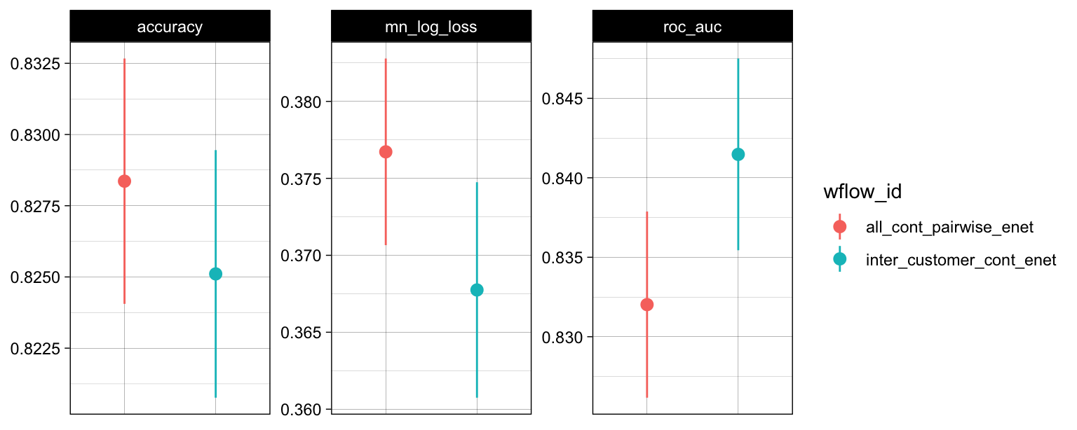
Classification Regularized Models (Elastic Net)
Two baseline models are selected for regularization with Elastic Net
Red: pairwise interactions for all continuous inputs, additive to categorical.
Teal: interact customer with all continuous inputs.
The model with interaction from customer has better performance.

Slide 20
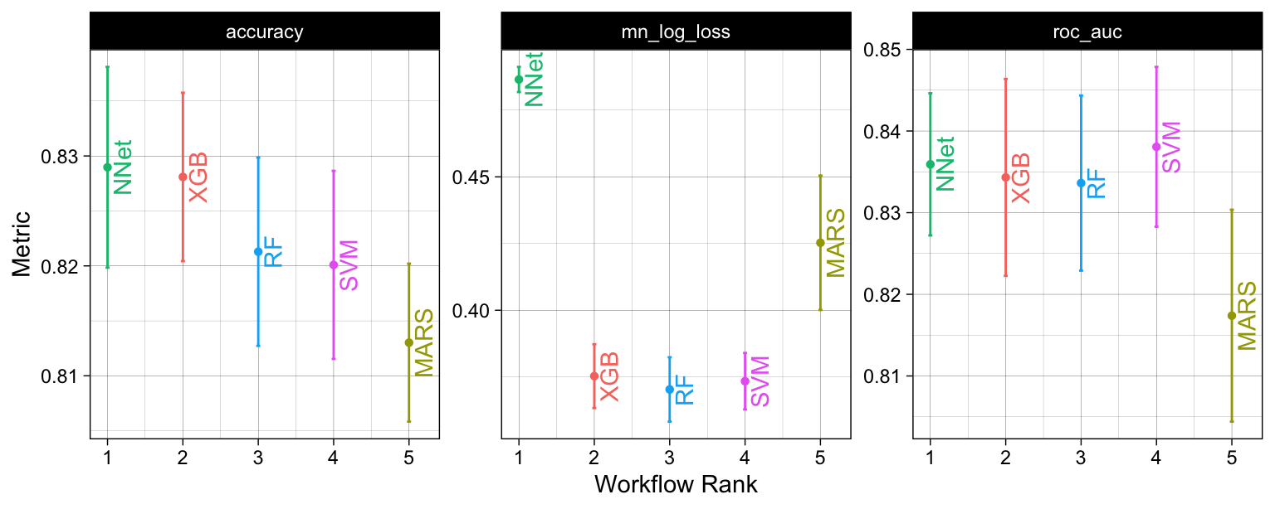
Classification Advanced Nonlinear Models
Five advanced models are tuned, each with 5x5 CV using tidymodels’ default tuning grids of 20 combinations for tuning parameters.
The best of each model is selected and compared.
The best model is identified as the XGB model.

Slide 21
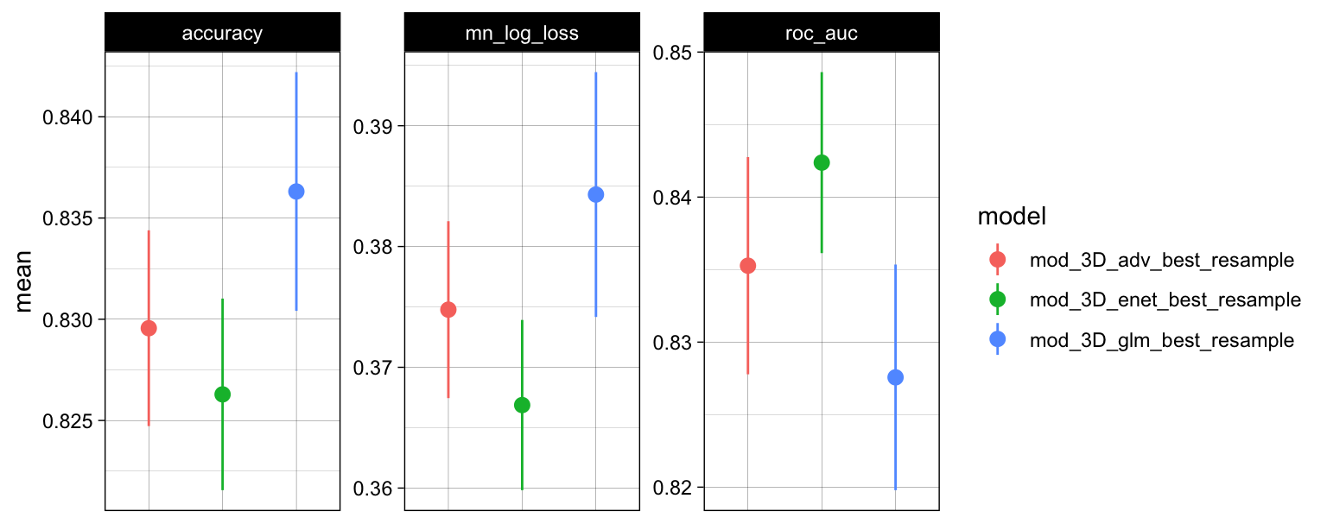
Classification Best Model
The best model from each section (baseline glm, regularized glm, advanced models) are pooled together for comparison.
The best model for the classification task is identified as the Elastic Net model with interaction from customer to all continuous inputs.

Slide 22
Conclusions
Analysis of key input features and model limitations.

Slide 23
Holdout Set Test Result
Make predictions using the holdout set that was not involved in model training.
The results are as follows:
Task | Metric | Score
Regression (predict sale time spent) | RMSE | 0.24
 | R-Squared | 0.81
 | MAE | 0.19
Classification (predict failing sale goal) | Accuracy | 0.82
 | Mean log loss | 0.47
 | ROC AUC | 0.84

Slide 24
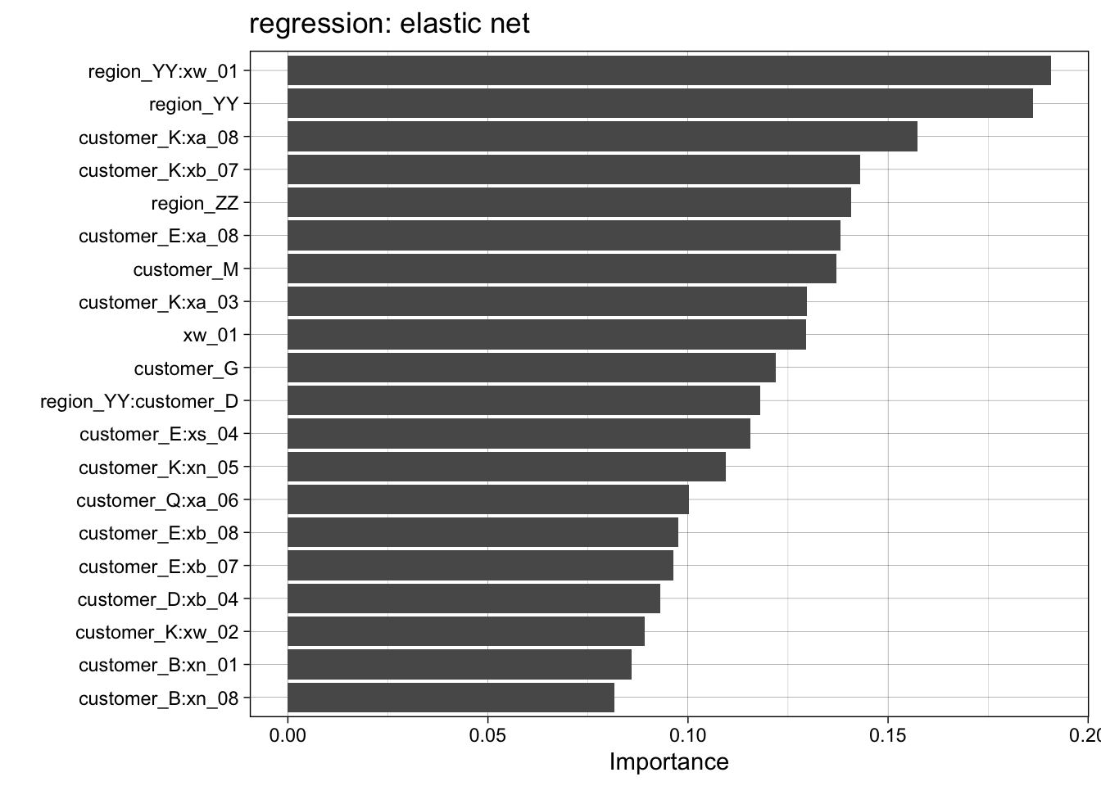
Regression Important Features
Top 20 important features from the best regression model.
The region categorical input is important.
Interaction from the customer categorical input is critical.
Some key continuous inputs are: xw_01, xa_08, xb_07
Rare to see input from xn_ or xs_ feature sets.

Slide 25
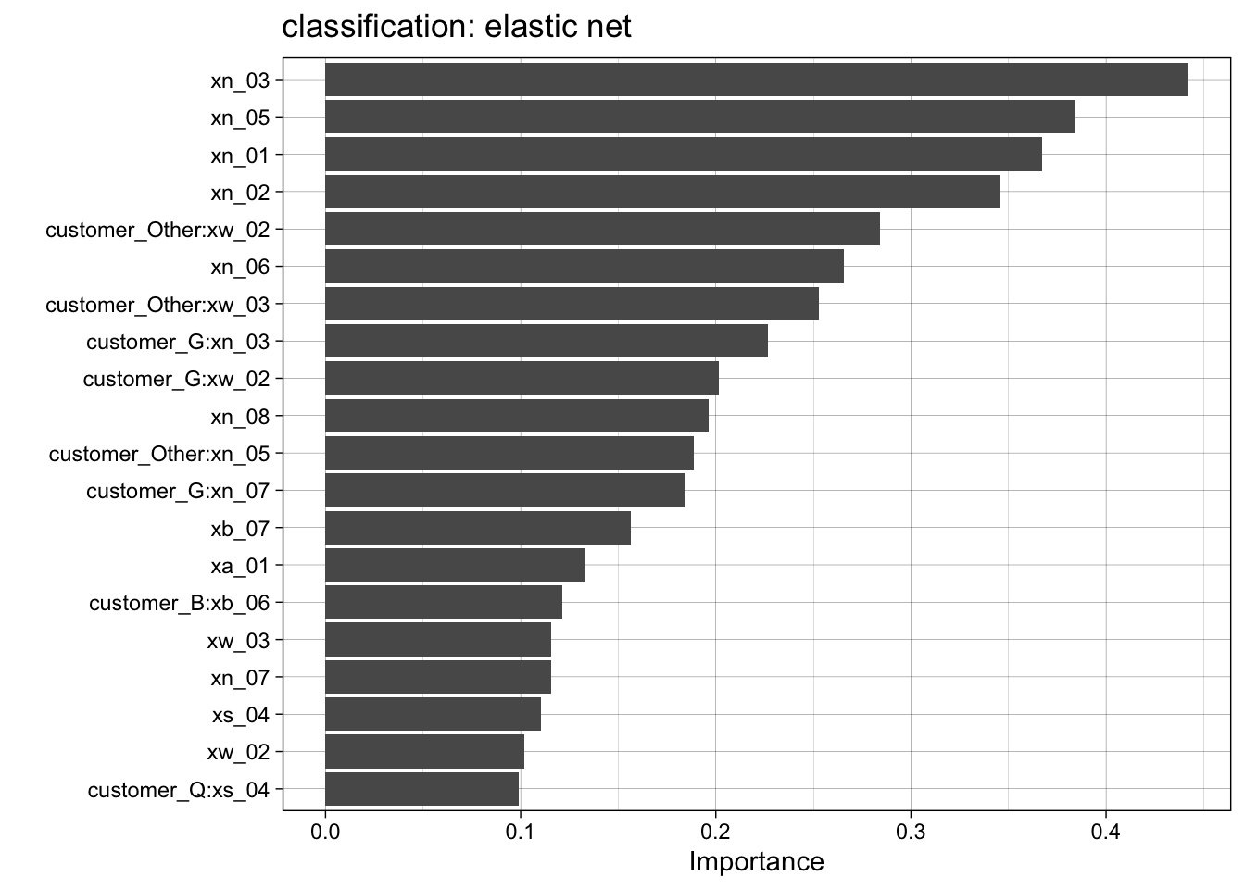
Classification Important Features
Top 20 important features from the best classification model.
The top ranked features are all the continuous inputs from the xn_ feature set.
Interaction from customer categorical input helps.
Rare to see input from xs_ and xw_ feature sets.

Slide 26
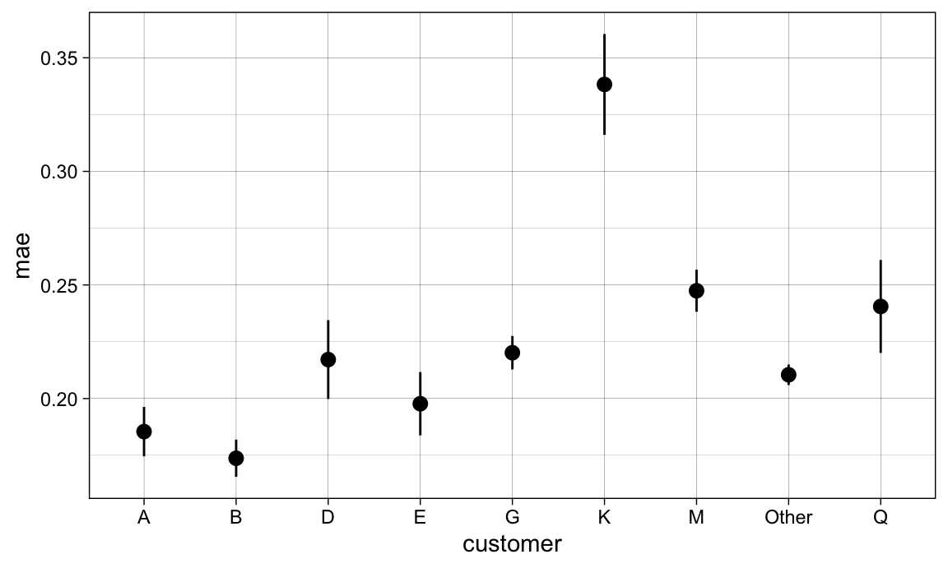
Regression Hard to Predict Customer
From my best regression model, compute the mean average error across the resampled folds to determine the customer that have highest prediction error.
It is hardest to predict the sale time spent on customer K using the best regression model.

Slide 27
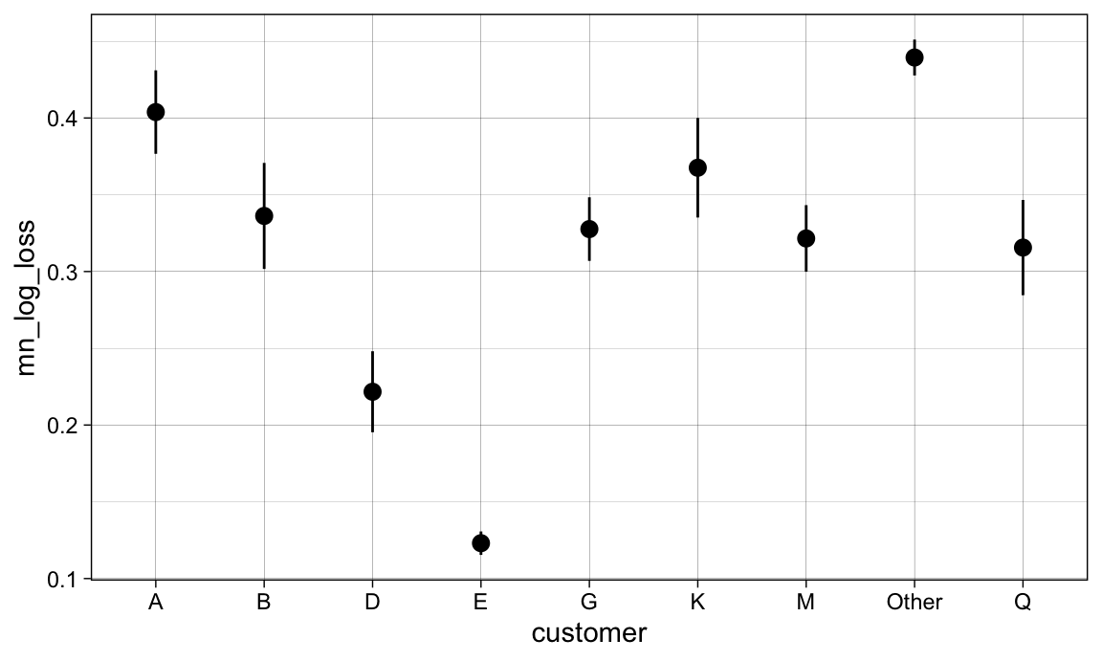
Classification Hard to Predict Customer
From my best classification model, compute the mean log loss across the resampled folds to determine the customer that have highest prediction error.
It is hardest to predict “meeting the sale goal” on customer Other. Since that is a pooled set, the immediate next hard to predict customer is A.

Slide 28
Summary
The formulation of the problem is mostly helpful to answer the questions.
In the regression task, most sentiment derived features require interaction with categorical inputs to predict the length of sale time. The word count feature `xw_01` appears to be only top ranked features without reliance on the interaction.
In the classification task, many sentiment derived features are helpful to predict failing the product sale goal. Notable ones are those from the NRC lexicon (`xn`).
The features derived from `sentimentr` appear to be least helpful in both tasks.
The models developed do have certain limitations.
Both my best regression and classification models depend highly on the customer categorical input.
This may prevent the models from working well with new customers. Ideally the model should rely on the sentiment derived features only to predict the outcomes.

